Slide 1




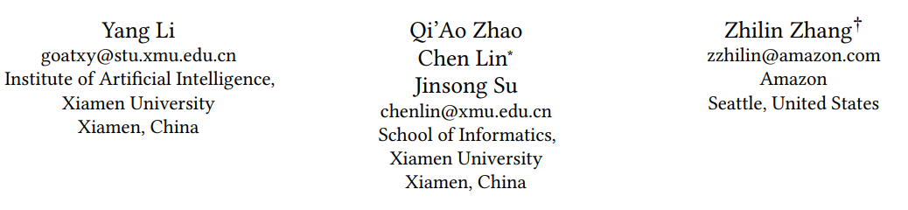





ATAI
Advanced Techniqueof Artificial Intelligence
ATAI
ChongqingUniversity _{AdvancedTechniqueof}
of Technology Artificial Intelligence
Chongqing University of
Technology
Chongqing University ^{ATAI}
_{of Technology} Advanced Techniqueof
Artificial Intelligence
Chongqing University of Technology
Chongqing University of Technology
Who To Align With: Feedback-Oriented Multi-Modal Alignment
in Recommendation Systems
Code: https://github.com/XMUDM/FETTLE
2024.9. 8•ChongQing
—— SIGIR 2024
Reported by Jinfei Chen
1

Slide 2

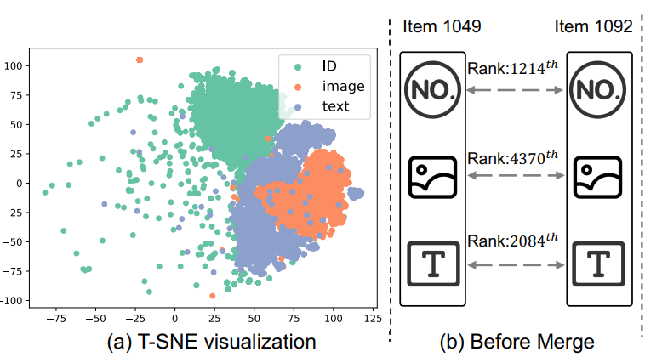
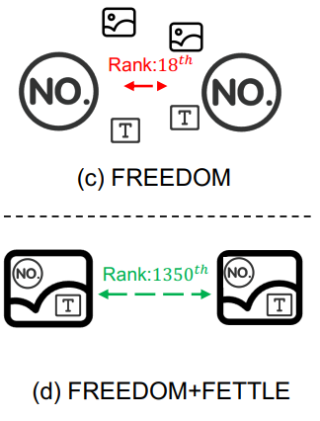
ATAI
AdvancedTechniqueof
Artificial Intelligence
ATAI
ChongqingUniversity _{AdvancedTechniqueof}
of Technology Artificial Intelligence
ChongqingUniversity of Technology
Motivation
1. Current MRSs overlook the large misalignment between multi-modal content features and ID embeddings
2. Modern MMMs typically utilize bidirectional alignment via contrastive learning. The alignment in MRSs should only be allowed in a one-way direction, depending on the user preference.

Slide 3

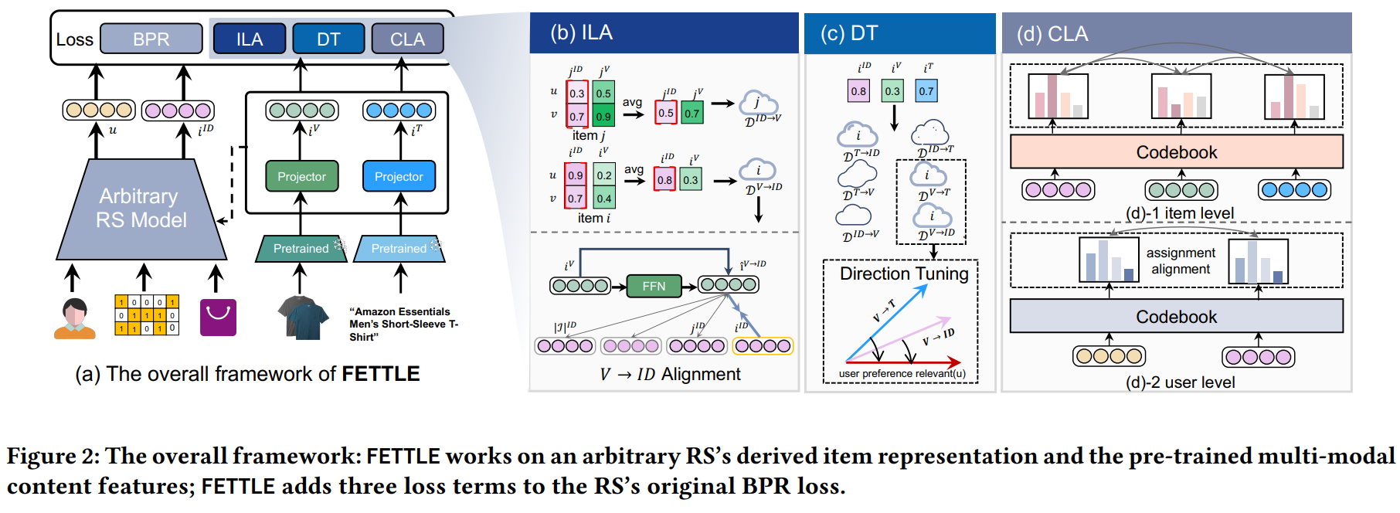
ChongqingUniversity of Technology
ATAI
AdvancedTechniqueof
Artificial Intelligence
ATAI
ChongqingUniversity _{AdvancedTechniqueof}
of Technology Artificial Intelligence
Overview

Slide 4

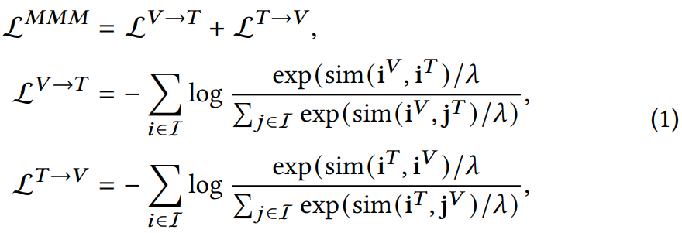
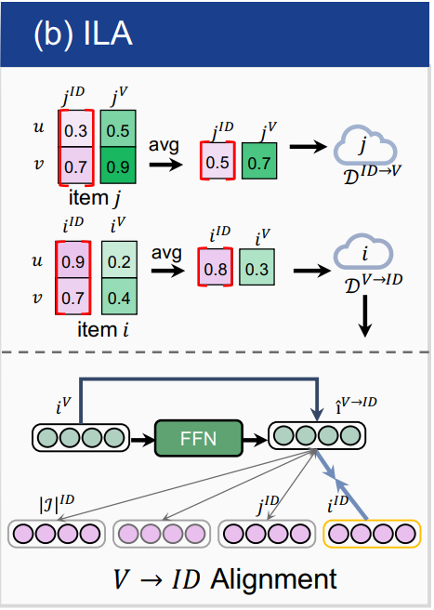
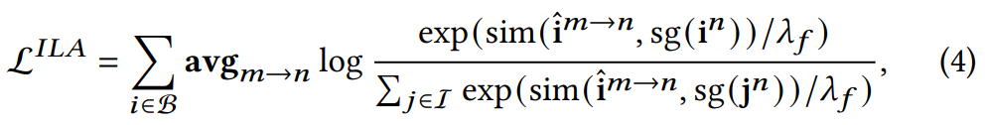
ChongqingUniversity of Technology
ATAI
AdvancedTechniqueof
Artificial Intelligence
ATAI
ChongqingUniversity _{AdvancedTechniqueof}
of Technology Artificial Intelligence
Method
Preliminaries

Slide 5
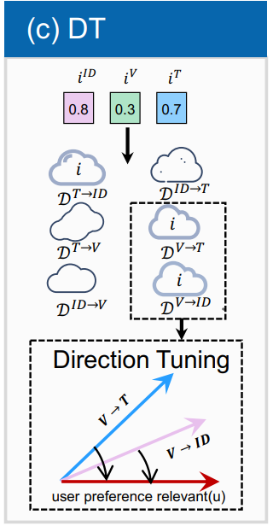
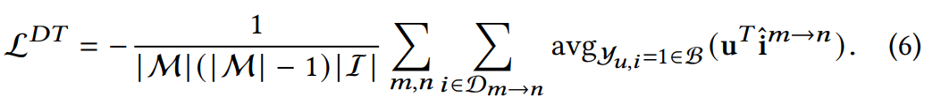
ChongqingUniversity of Technology
ATAI
AdvancedTechniqueof
Artificial Intelligence
ATAI
ChongqingUniversity _{AdvancedTechniqueof}
of Technology Artificial Intelligence
Method

Slide 6
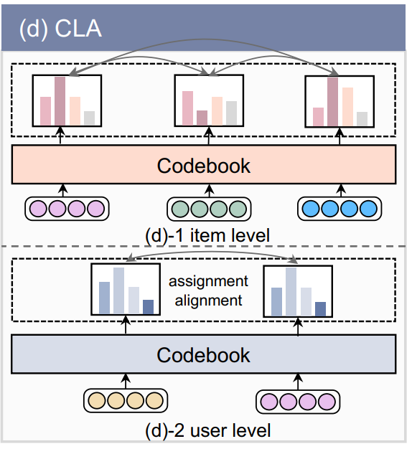
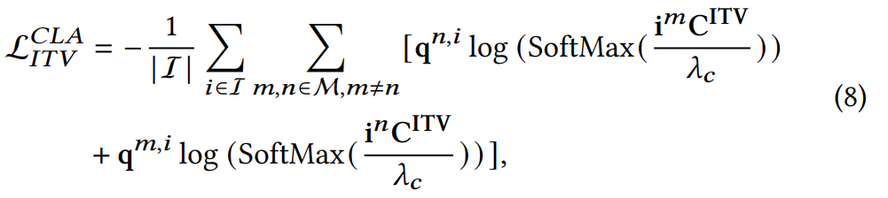
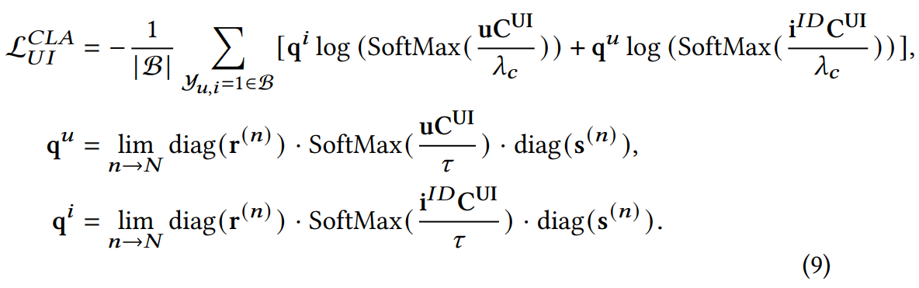
ChongqingUniversity of Technology
ATAI
AdvancedTechniqueof
Artificial Intelligence
ATAI
ChongqingUniversity _{AdvancedTechniqueof}
of Technology Artificial Intelligence
Method

Slide 7
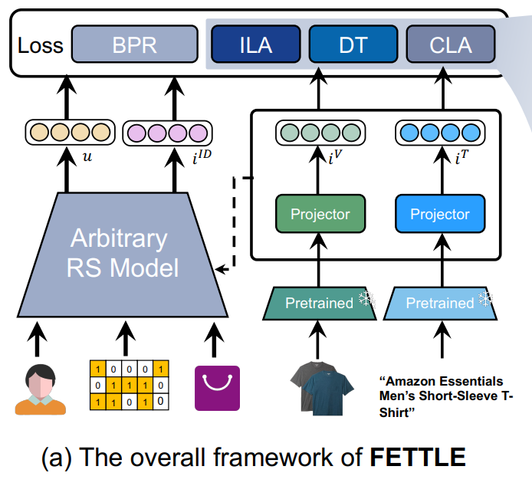
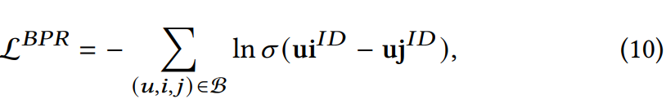
ChongqingUniversity of Technology
ATAI
AdvancedTechniqueof
Artificial Intelligence
ATAI
ChongqingUniversity _{AdvancedTechniqueof}
of Technology Artificial Intelligence
Method

Slide 8

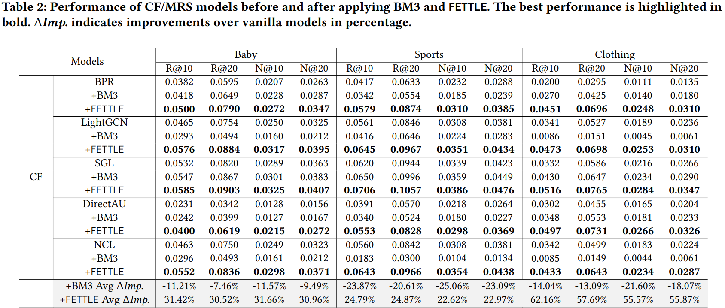
ATAI
AdvancedTechniqueof
Artificial Intelligence
ATAI
ChongqingUniversity _{AdvancedTechniqueof}
of Technology Artificial Intelligence
ChongqingUniversity of Technology
Experiments

Slide 9
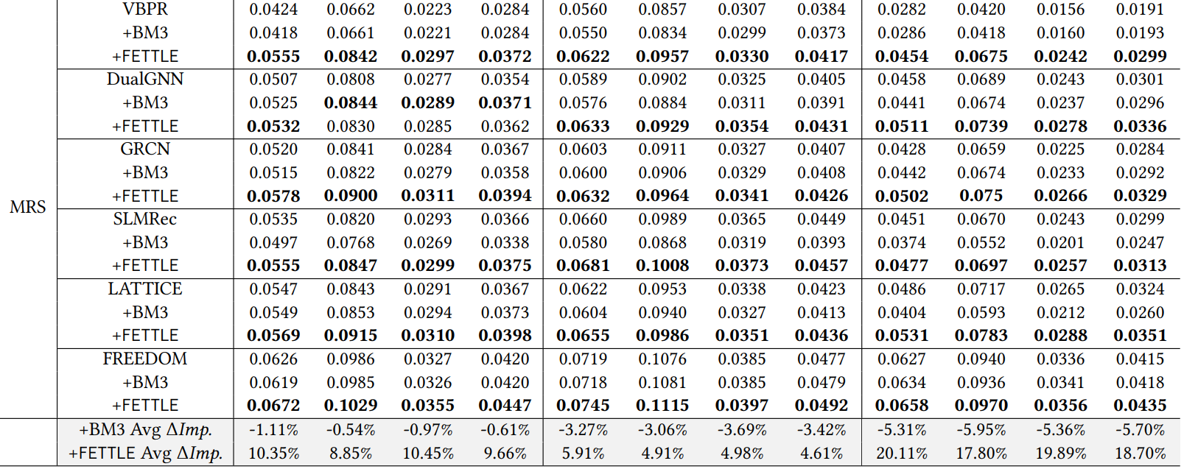
ATAI
AdvancedTechniqueof
Artificial Intelligence
ATAI
ChongqingUniversity _{AdvancedTechniqueof}
of Technology Artificial Intelligence
ChongqingUniversity of Technology
Experiments

Slide 10
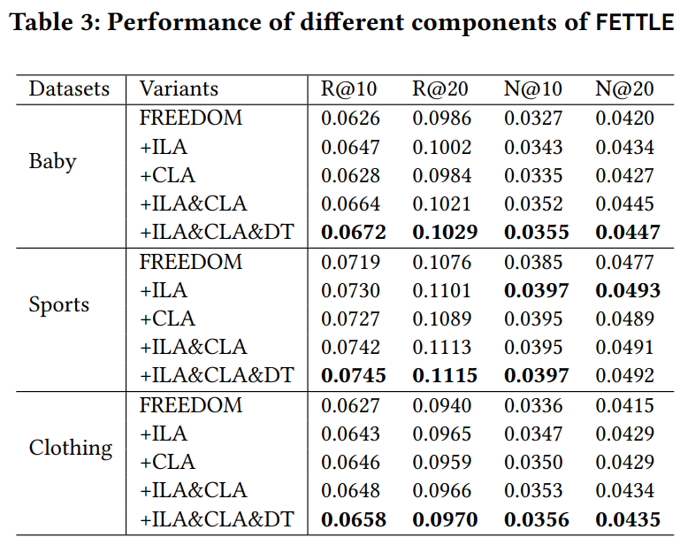
ATAI
AdvancedTechniqueof
Artificial Intelligence
ATAI
ChongqingUniversity _{AdvancedTechniqueof}
of Technology Artificial Intelligence
ChongqingUniversity of Technology
Experiments

Slide 11
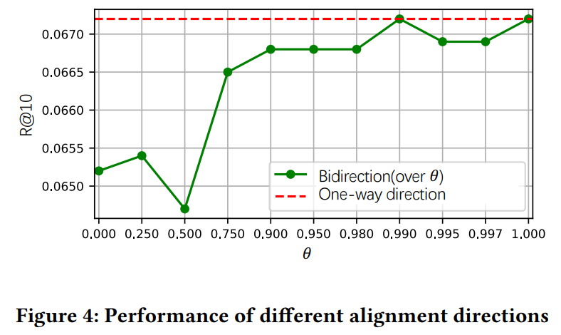
ATAI
AdvancedTechniqueof
Artificial Intelligence
ATAI
ChongqingUniversity _{AdvancedTechniqueof}
of Technology Artificial Intelligence
ChongqingUniversity of Technology
Experiments

Slide 12
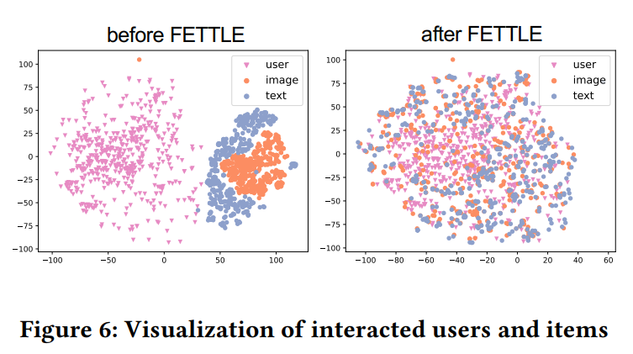
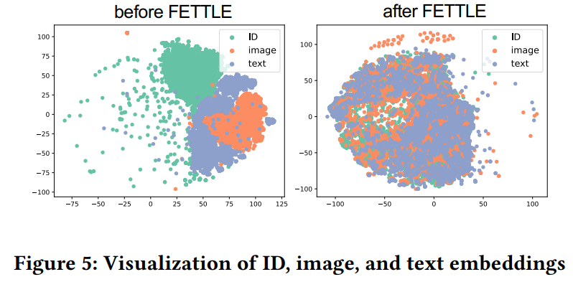
ATAI
AdvancedTechniqueof
Artificial Intelligence
ATAI
ChongqingUniversity _{AdvancedTechniqueof}
of Technology Artificial Intelligence
ChongqingUniversity of Technology
Experiments

Slide 13
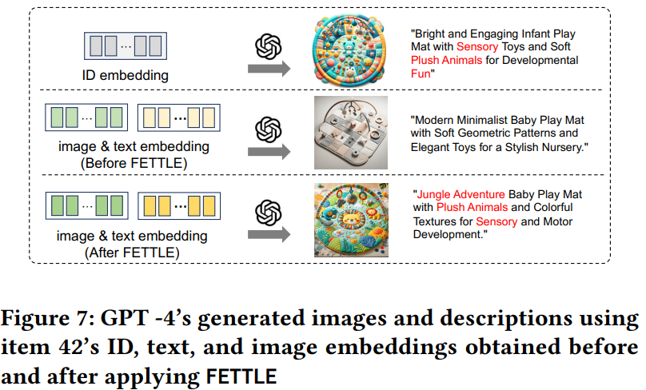
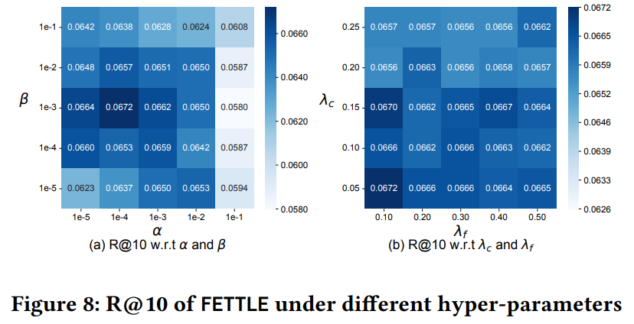
ATAI
AdvancedTechniqueof
Artificial Intelligence
ATAI
ChongqingUniversity _{AdvancedTechniqueof}
of Technology Artificial Intelligence
ChongqingUniversity of Technology
Experiments

Slide 14


ChongqingUniversity of Technology
ATAI
AdvancedTechniqueof
Artificial Intelligence
ATAI
ChongqingUniversity _{AdvancedTechniqueof}
of Technology Artificial Intelligence
Thanks!

